Slide 1
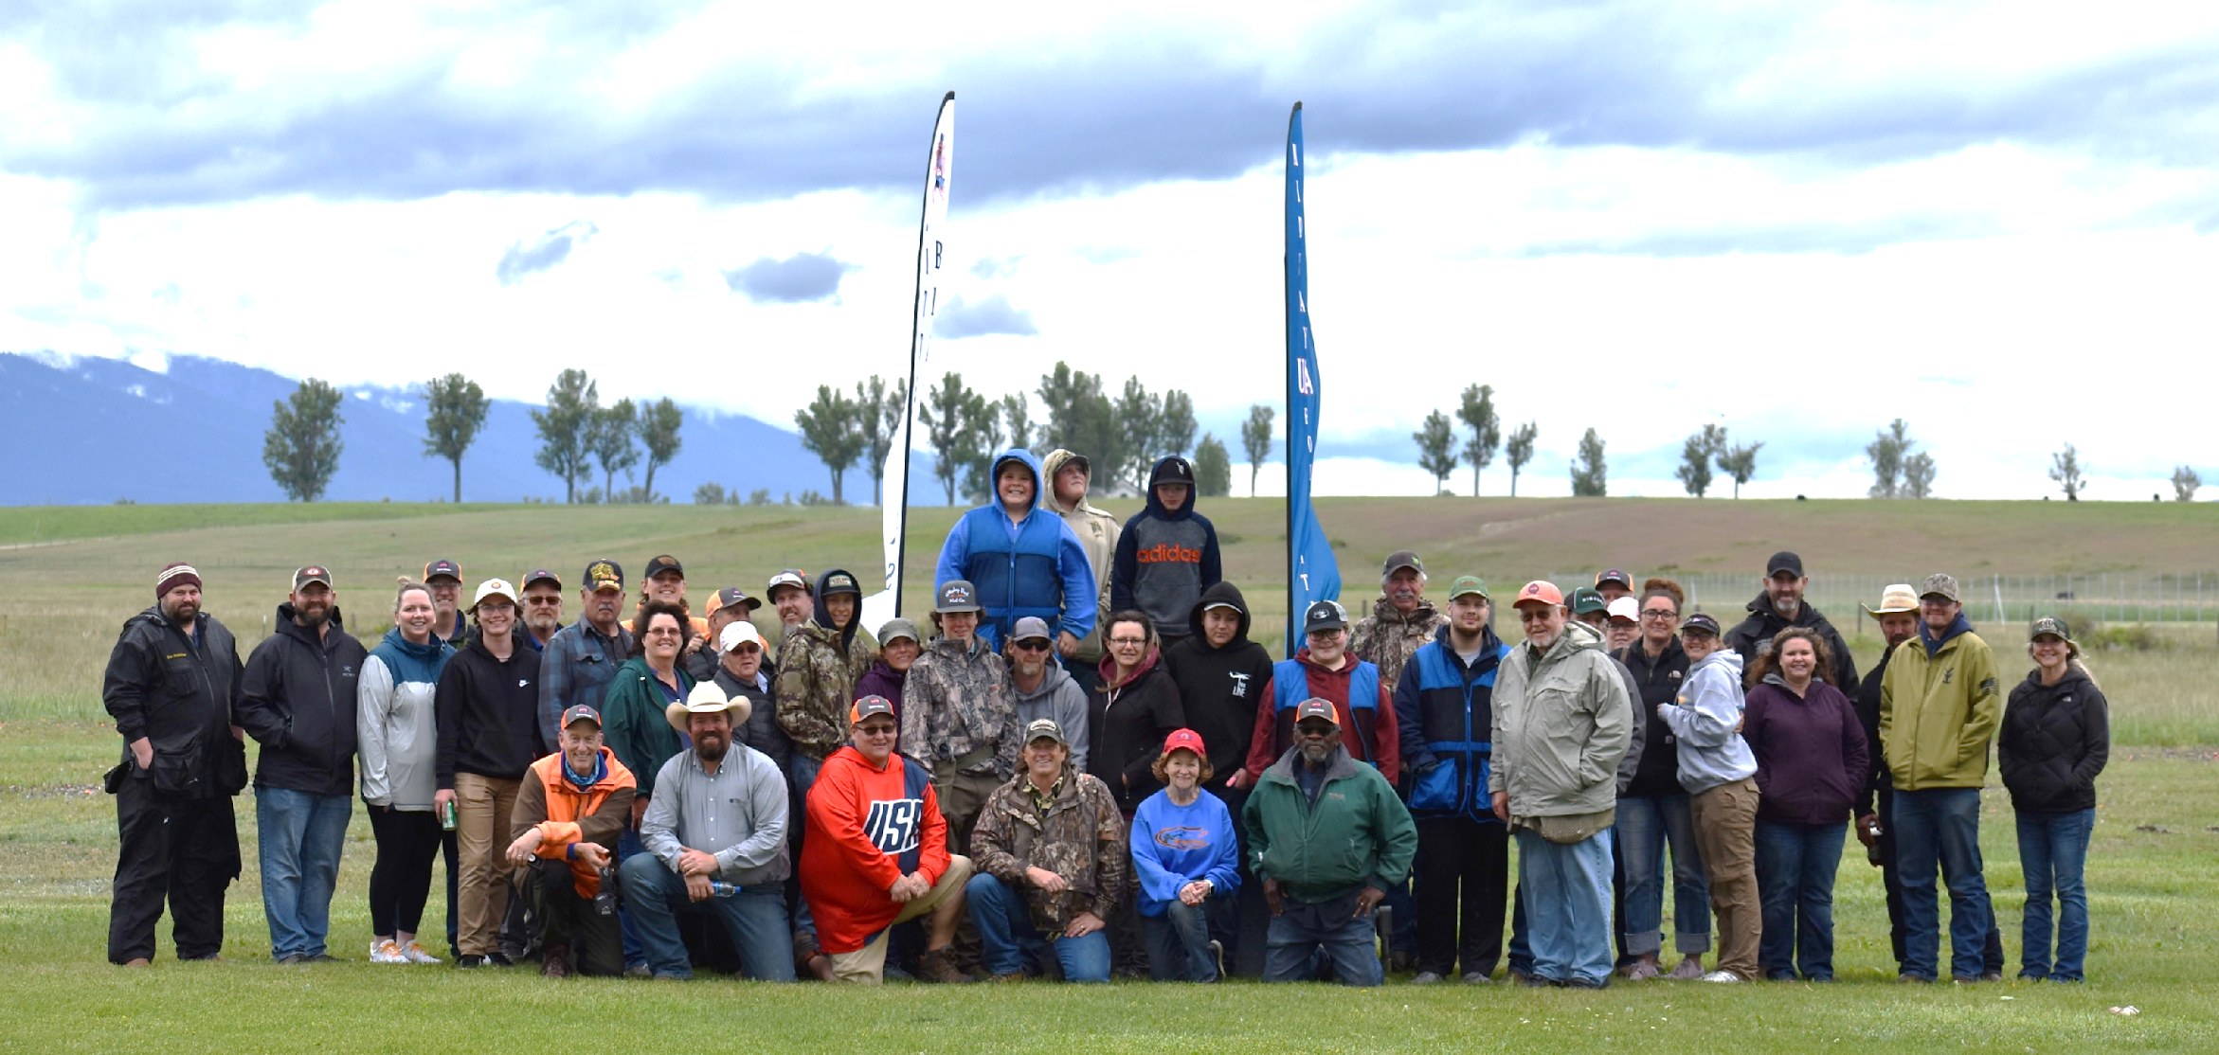
Bitterroot Sporting Club
A Community Endeavor

Slide 2
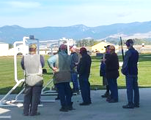
Who We Are…
Bitterroot Sporting Club, formerly Hamilton Gun Club, is a non-profit 501(c)(3) organization providing opportunities to the community by providing:
Clay Target Shooting Facilities
Firearm Educational Opportunities
Charitable Shooting Events
And much more!

Slide 3
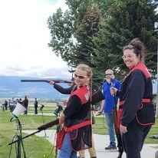
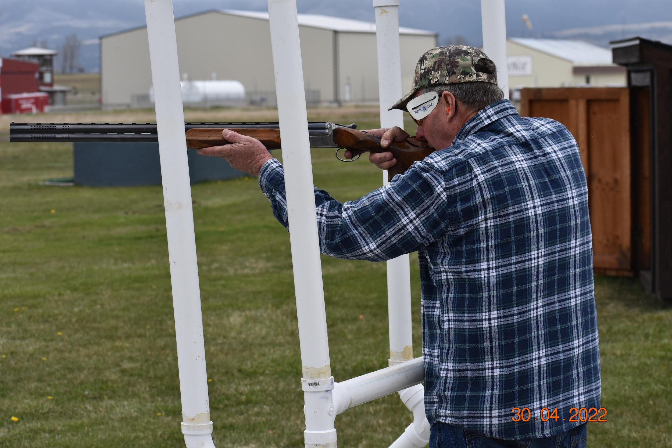
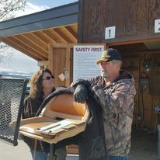
BSC Offers:
Spring League
Women’s League
Bitterroot Blasters Youth
Shooting Team
Fundraising Shoots for
Montana Non-Profits
Coaching & Support
BSC Is Available To:
The Public
Senior Citizens
School Groups
Church Groups
Youth Groups
Visitors/Tourists
Both New & Experienced Shooters

Slide 4
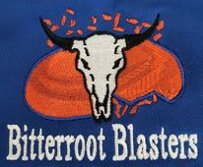
We’re here to provide shooting opportunities to our community and we like to give back! We hold several fundraising events throughout the year. A few of these events include: Shriners Shoot Hope Shoot Blasters Open

Slide 5
Community Fundraising
Shriners Shoot
Shoot for Hope
BSC has held the Shriners Shoot for 19 years to raise money for Montana families that need to travel to the nearest Shriners Hospital in Spokane, WA. For our community, this means Spokane, WA. These funds help to cover expenses such as food, gas, and lodging.
Over the past 19 years, over $160,000 have been raised. In 2023, the goal was to raise $10,000 and the successful event managed to beat that goal and raise $12,337.
This year, BSC will be hosting the 4th Annual Shoot for Hope with proceeds benefiting the Montana Hope Project.
The Montana Hope Project was started by the Montana Highway Patrol to fulfill the dreams and wishes of Montana children who suffer from a terminal, critical, or chronic illness.
Join us on August 10th to help support this great organization. Registration starts at 7am with shooting starting at 8am.

Slide 6
Community Fundraising
Blasters Open
Other Fundraising
The Blasters Open is a great way for the Bitterroot Blasters to end their season. It is a fundraiser that supports the team and brings everyone together for a good day of shooting.
Team members are encouraged to shoot with parents, grandparents, aunts, uncles, friends, coaches, or others who matter in their lives.
This shoot typically raises around $4000 each year to help support the Bitterroot Blasters kids.
BSC has extended our facilities to others for fundraising shoots including the Bill Reed Benefit Shoot and the Boxing Club.
We are always willing to discuss new ways to help our community and are very grateful for all the love and support received through these events!

Slide 7
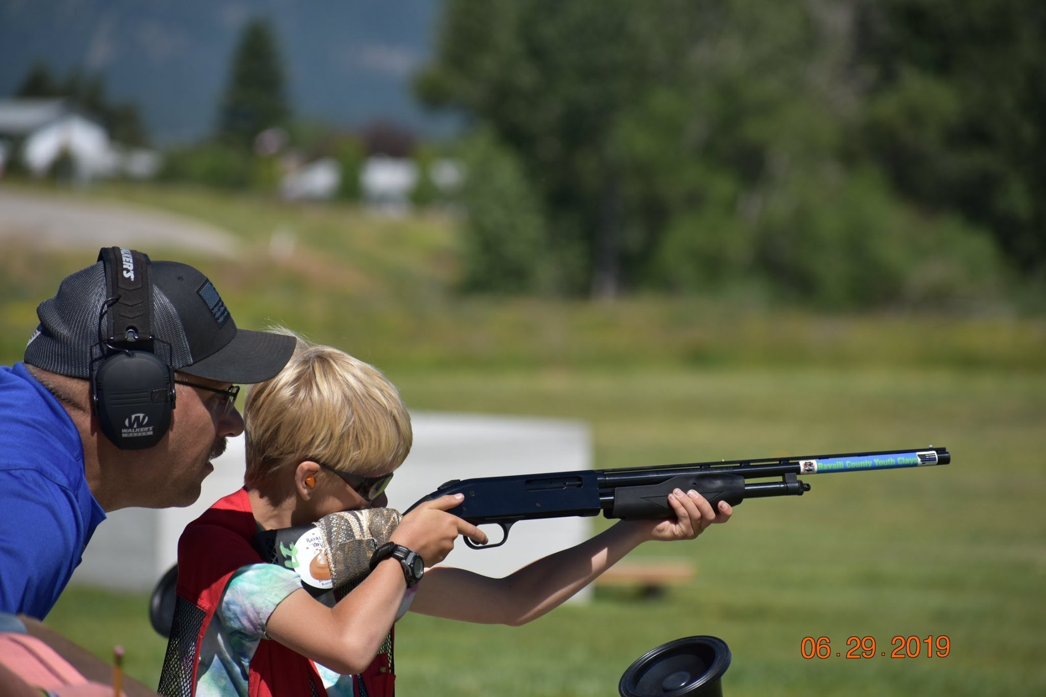
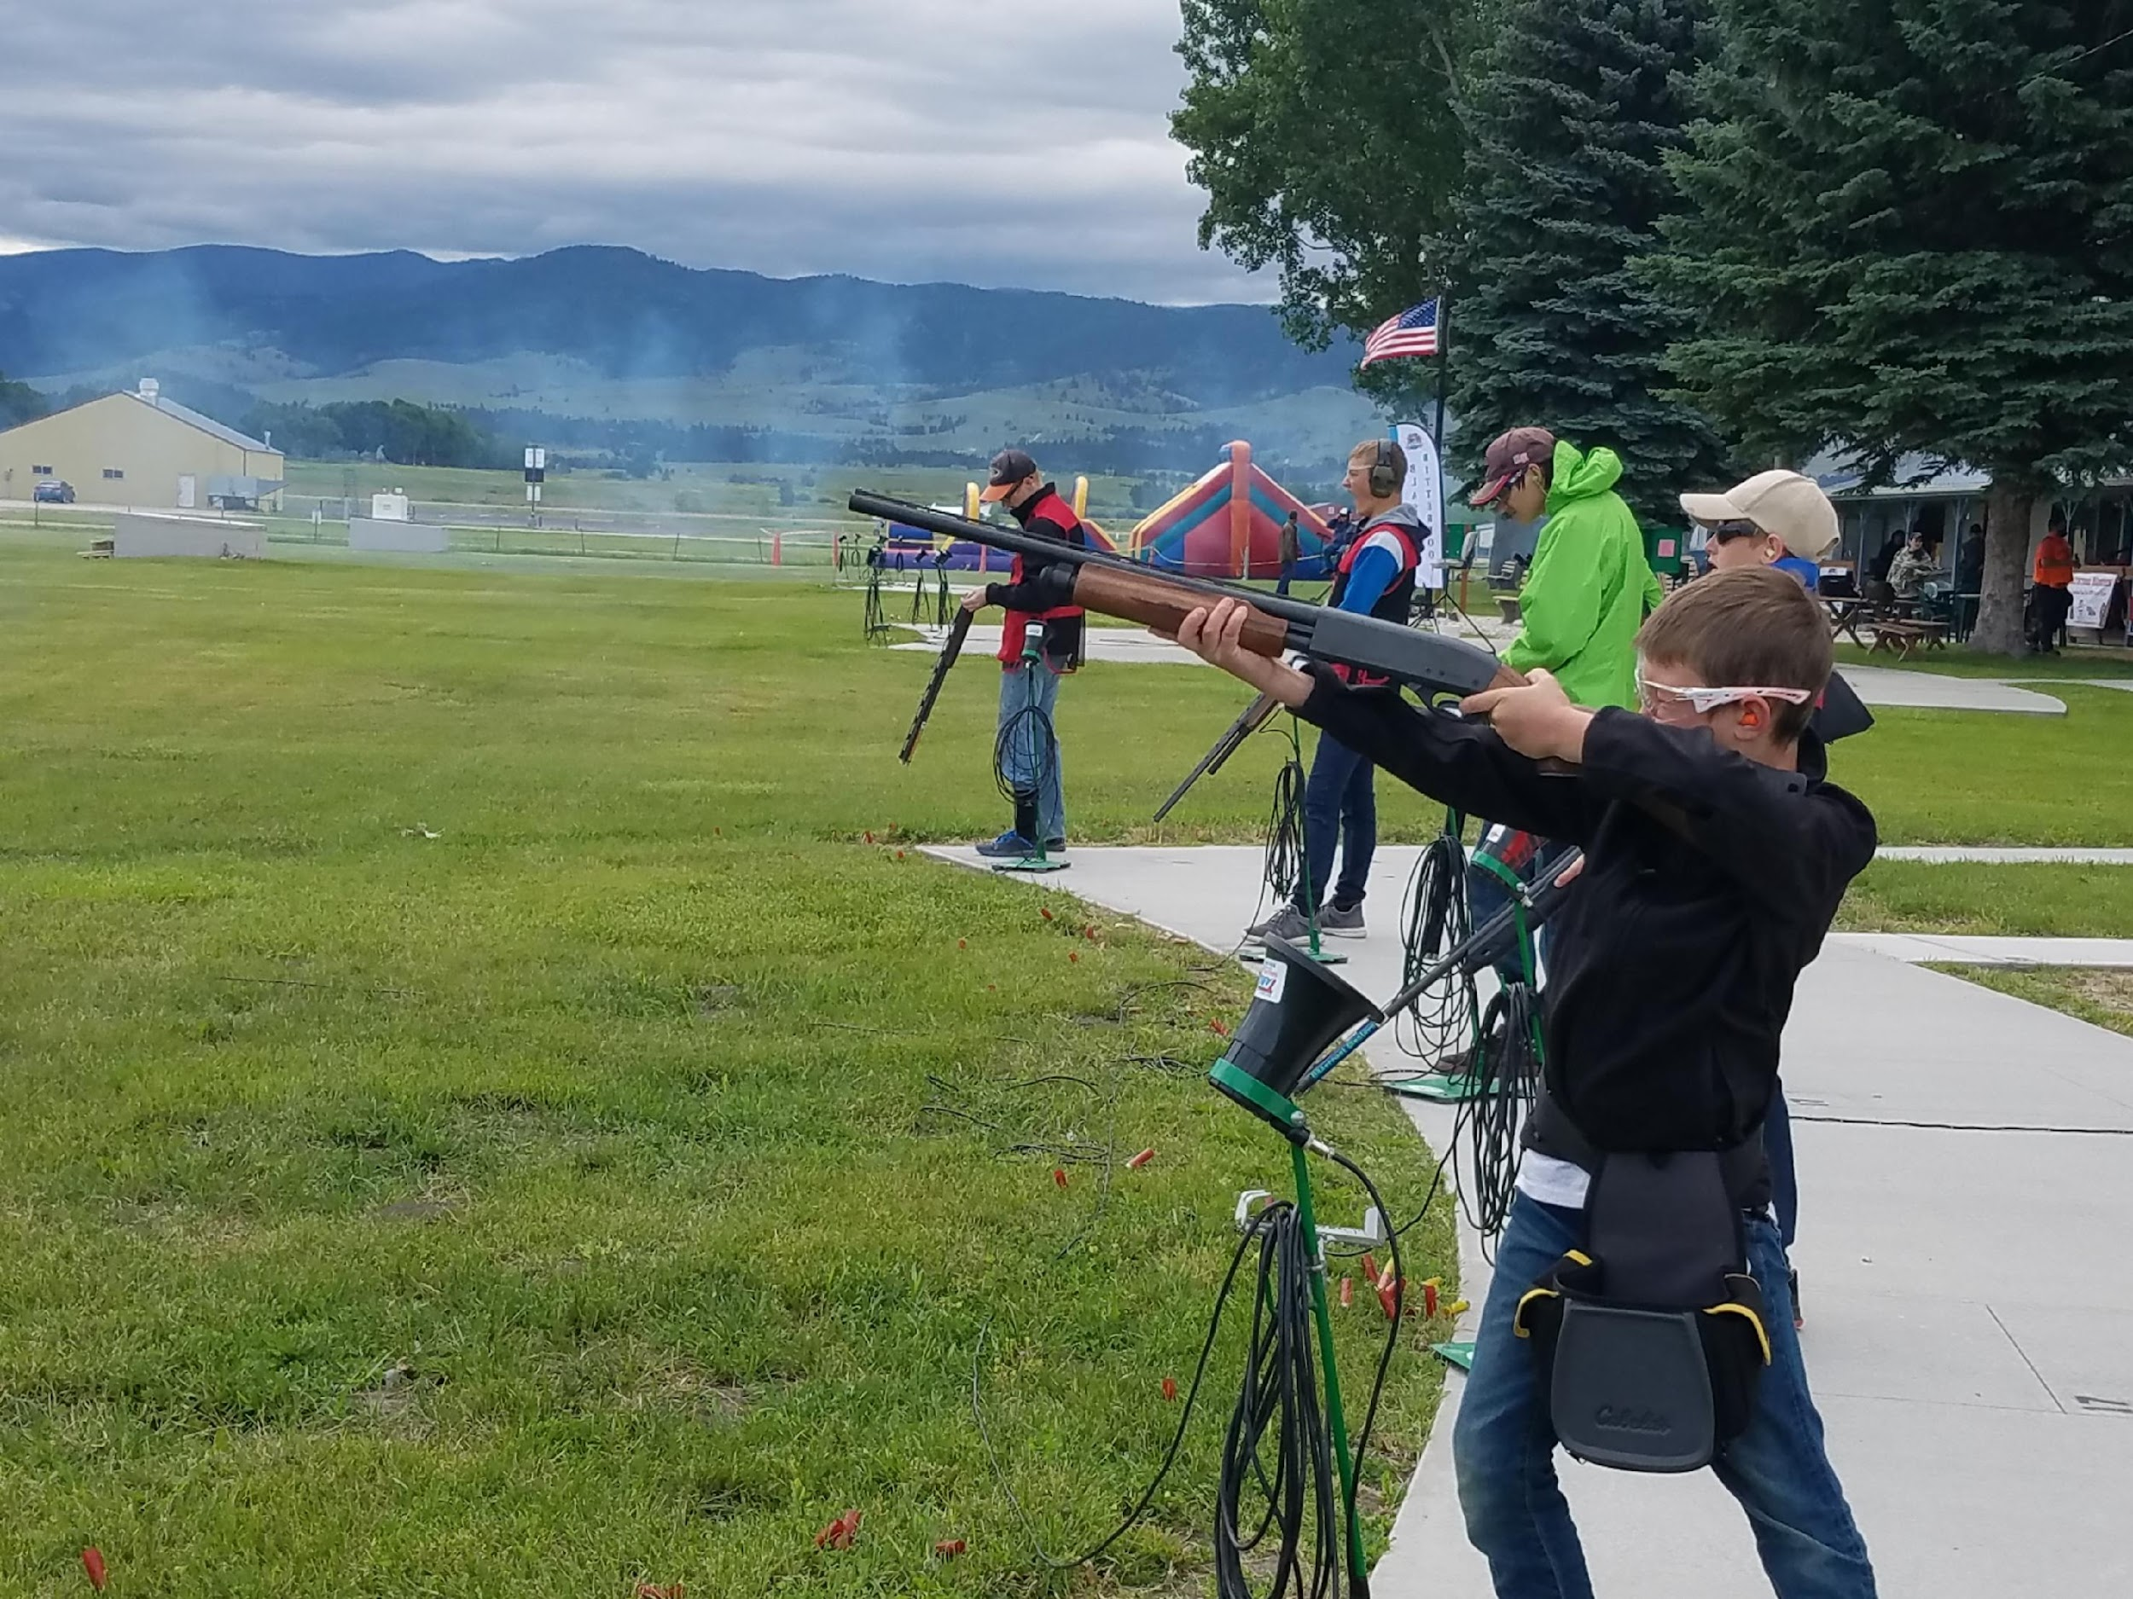
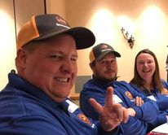
Bitterroot Blasters: Supporting Our Youth Since 2013

Slide 8
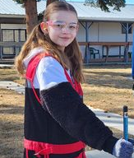
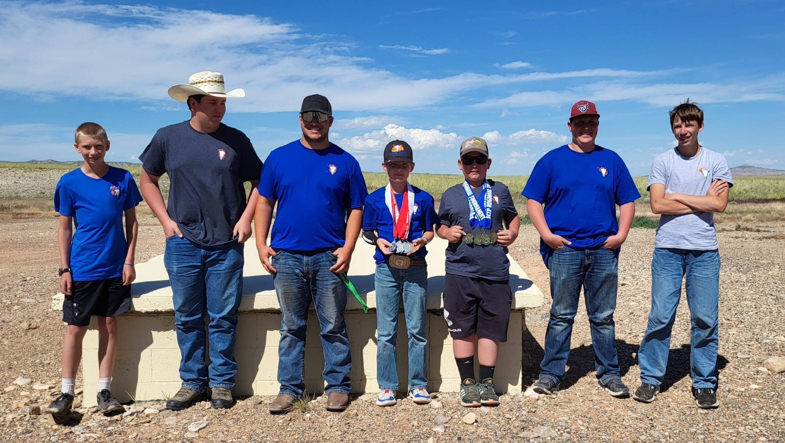
Bitterroot Blasters – The largest youth shooting team in a 3-state area.
40 Team Members between 9-18 years old.
15 NRA Trained Volunteer Coaches
Principal Lessons:
Gun Safety
Range Safety
Sportsmanship

Slide 9
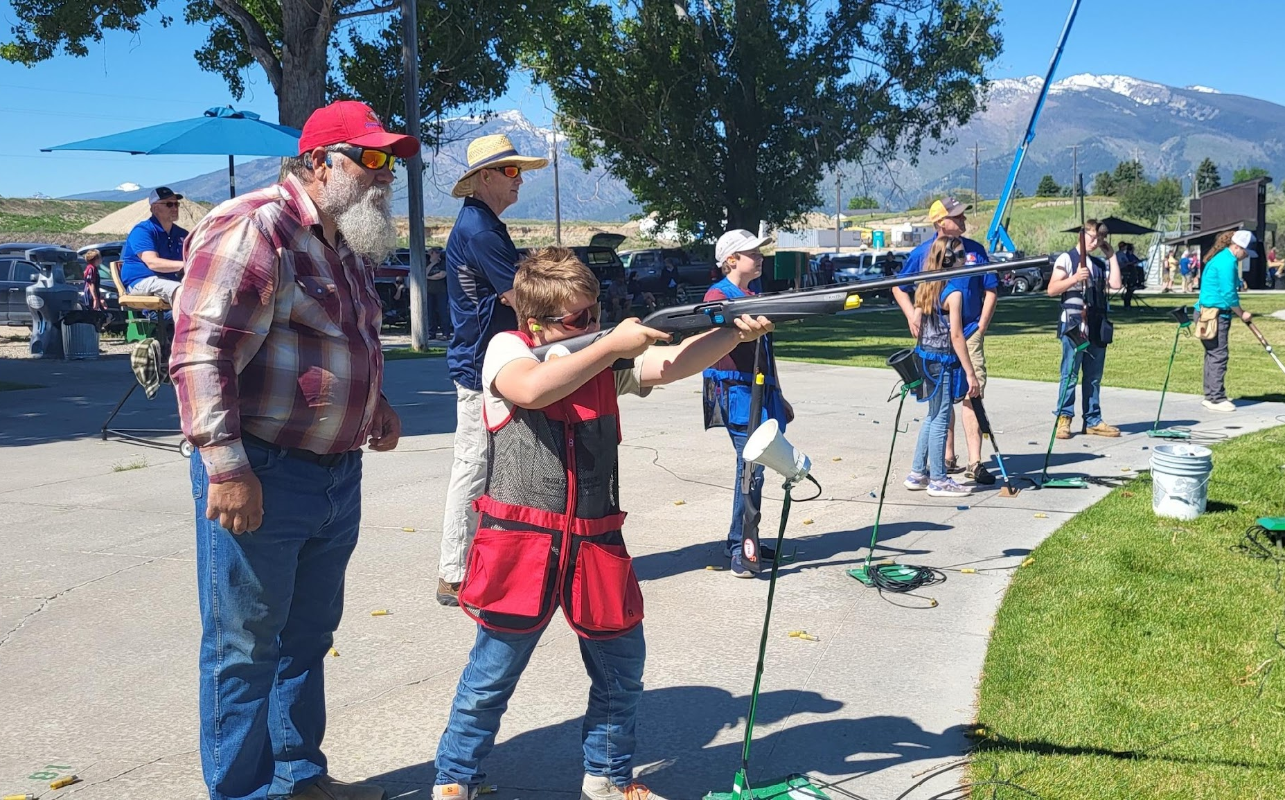
Bitterroot Blasters has been training kids since 2013 and since that time, hundreds of kids have been trained through the program. The original team started with a small group of 10 kids and over time the team exploded into 70 kids. Today’s team has been cut down and now consists of 40 kids. This is a great size for us to ensure we have enough trained coaches and that each team member is able to get the individual instruction to needed to be
safe and learn to shoot. Our program runs from March through June with our big fundraising shoot rounding it up at the end of the season.
We are a family organization with parents, grandparents, and siblings all involved. We do a family shoot at Big Sky Sporting Clays every May and also have the amazing opportunity to take a group of kids to the Cody Roundup in Cody, WY each year. This is a 3-day regional shoot and even though it is just for the athletes registered, it is a fun family trip.
The Blasters are not just a team, we are a family. We joke that once you are a Blaster, you are always a Blaster and we ensure each of these kids know if they ever need anything, they can reach out to a coach at any time. The kids make lifetime memories, learn gun safety, range safety, and sportsmanship. Our kids build confidence, courage, and learn they can do hard things.
Some of our girls on the team welcome you to challenge them in a shoot. They would love to help you earn a “Beat by a Girl” pin.

Slide 10
League Shooting
BSC offers multiple League shooting opportunities including Spring League, Doubles, Wobbles, 5-Stand and our newest addition of Ladies League.
The Spring League typically serves around 50 shooters or 10 teams.
BSC’s Womens League started in 2023 with 5 ladies and this year has grown to 15 registered shooters. The league started in Kalispell with the Passionate Outlaws and has grown by a tremendous amount with the formation of multiple teams across the state of Montana and now even includes a team in Berthoud, CO! Our year end state shoot is September 7th in Kalispell.

Slide 11
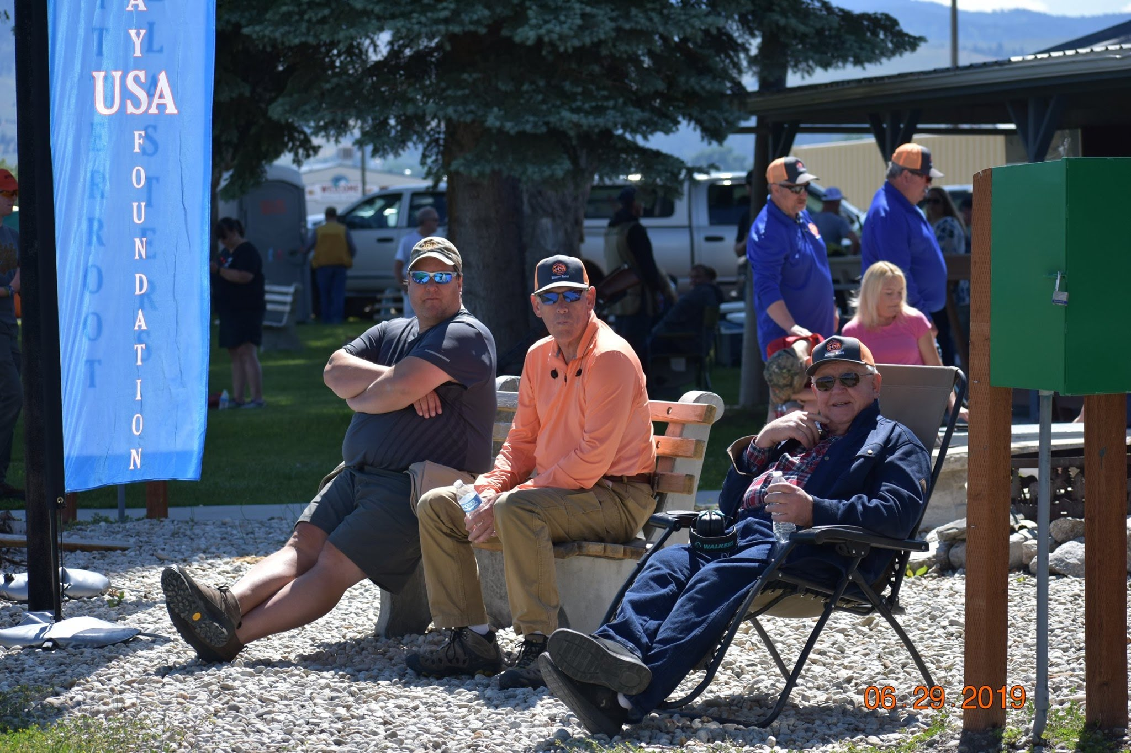
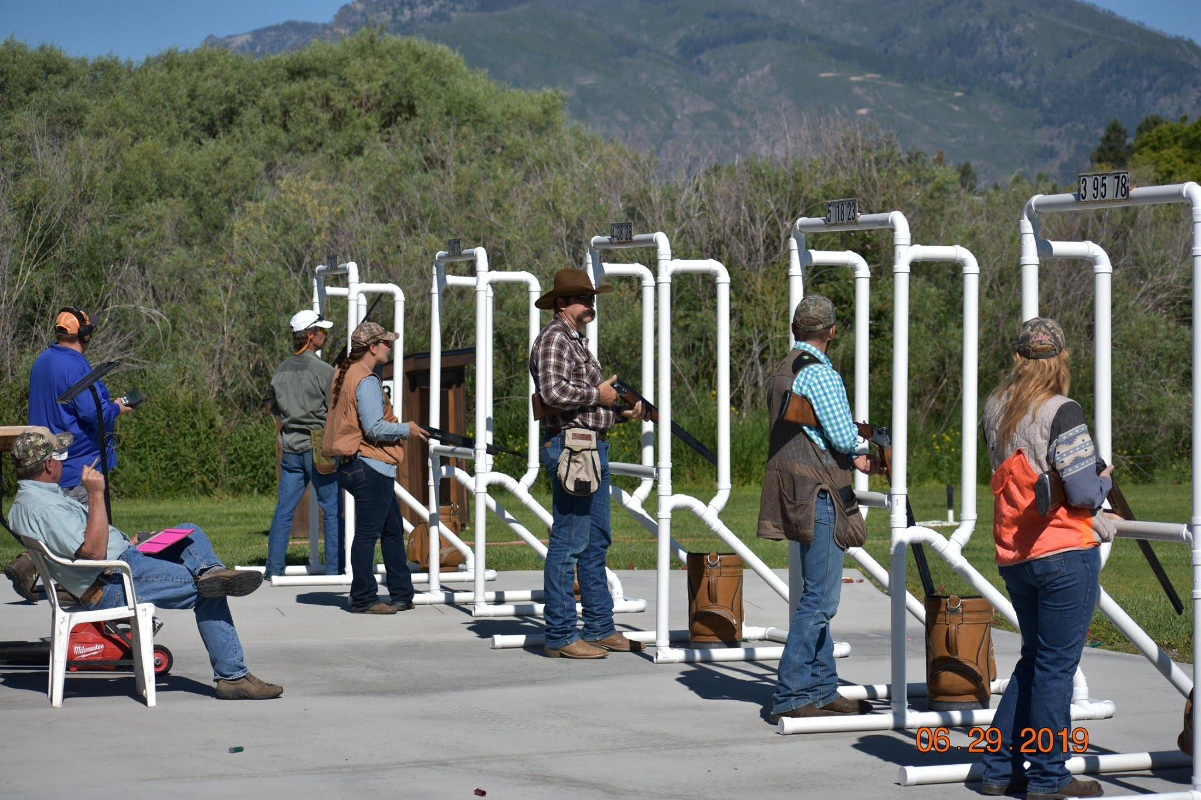
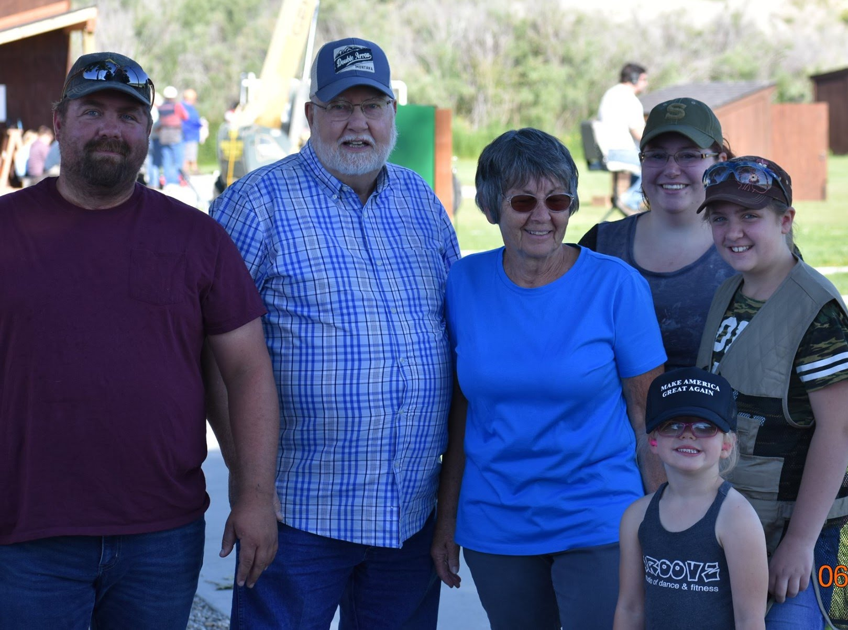
Other Great Things…
BSC brings people together. It is a place where senior citizens come to enjoy some company, a place where families spend time together, and friends gather to have some fun. BSC is a positive, encouraging environment with a strong community focus. It supports the shooting sports in a responsible and safe manner and continually gives back. You will not find more dedicated volunteers anywhere and you will quickly find you have become a part of a much larger family. It is our hope to continue this legacy that was started so long ago and has become a part of our Montana history.

Slide 12
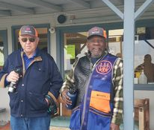
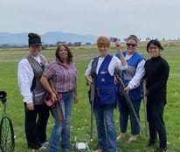
Why Does BSC Need A New Location?
Bitterroot Sporting Club is currently leasing property from Ravalli County. The Club has been on this land since 1947 but due to the airport expansion and the sewer updates currently being implemented, we have been notified that the lease will not be renewed. With that, the work began to find a new home for this community treasure.

Slide 13
Our Current Facilities
The Club House
Main Social Area/Front Desk/Concessions
Eating Area
Bathrooms
Shop Area with Storage
Parking Area
Conex Storage Box

Slide 14
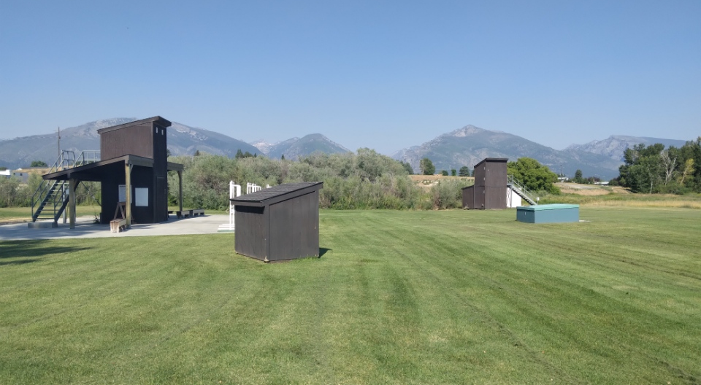
The Fields
3 Poured Concrete Trap Fields for 16-27 Yard Shooting
5-Stand Field
Grounds are meticulously maintained by volunteers
Underground Sprinkler System
Shot is periodically reclaimed on an as needed basis

Slide 15
Maintenance
Several volunteers donate their time and energy to help maintain our facility. Every Tuesday, these dedicated individuals help load the trap houses, empty garbages, and mow the fields along with any other work that may be needed. We can’t thank them enough for their commitment and hard work!
A unique feature of BSC is that it is run by volunteers. There are no paid positions which helps to keep the costs down.

Slide 16
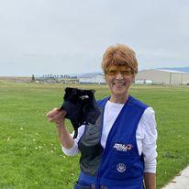
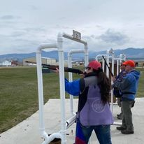
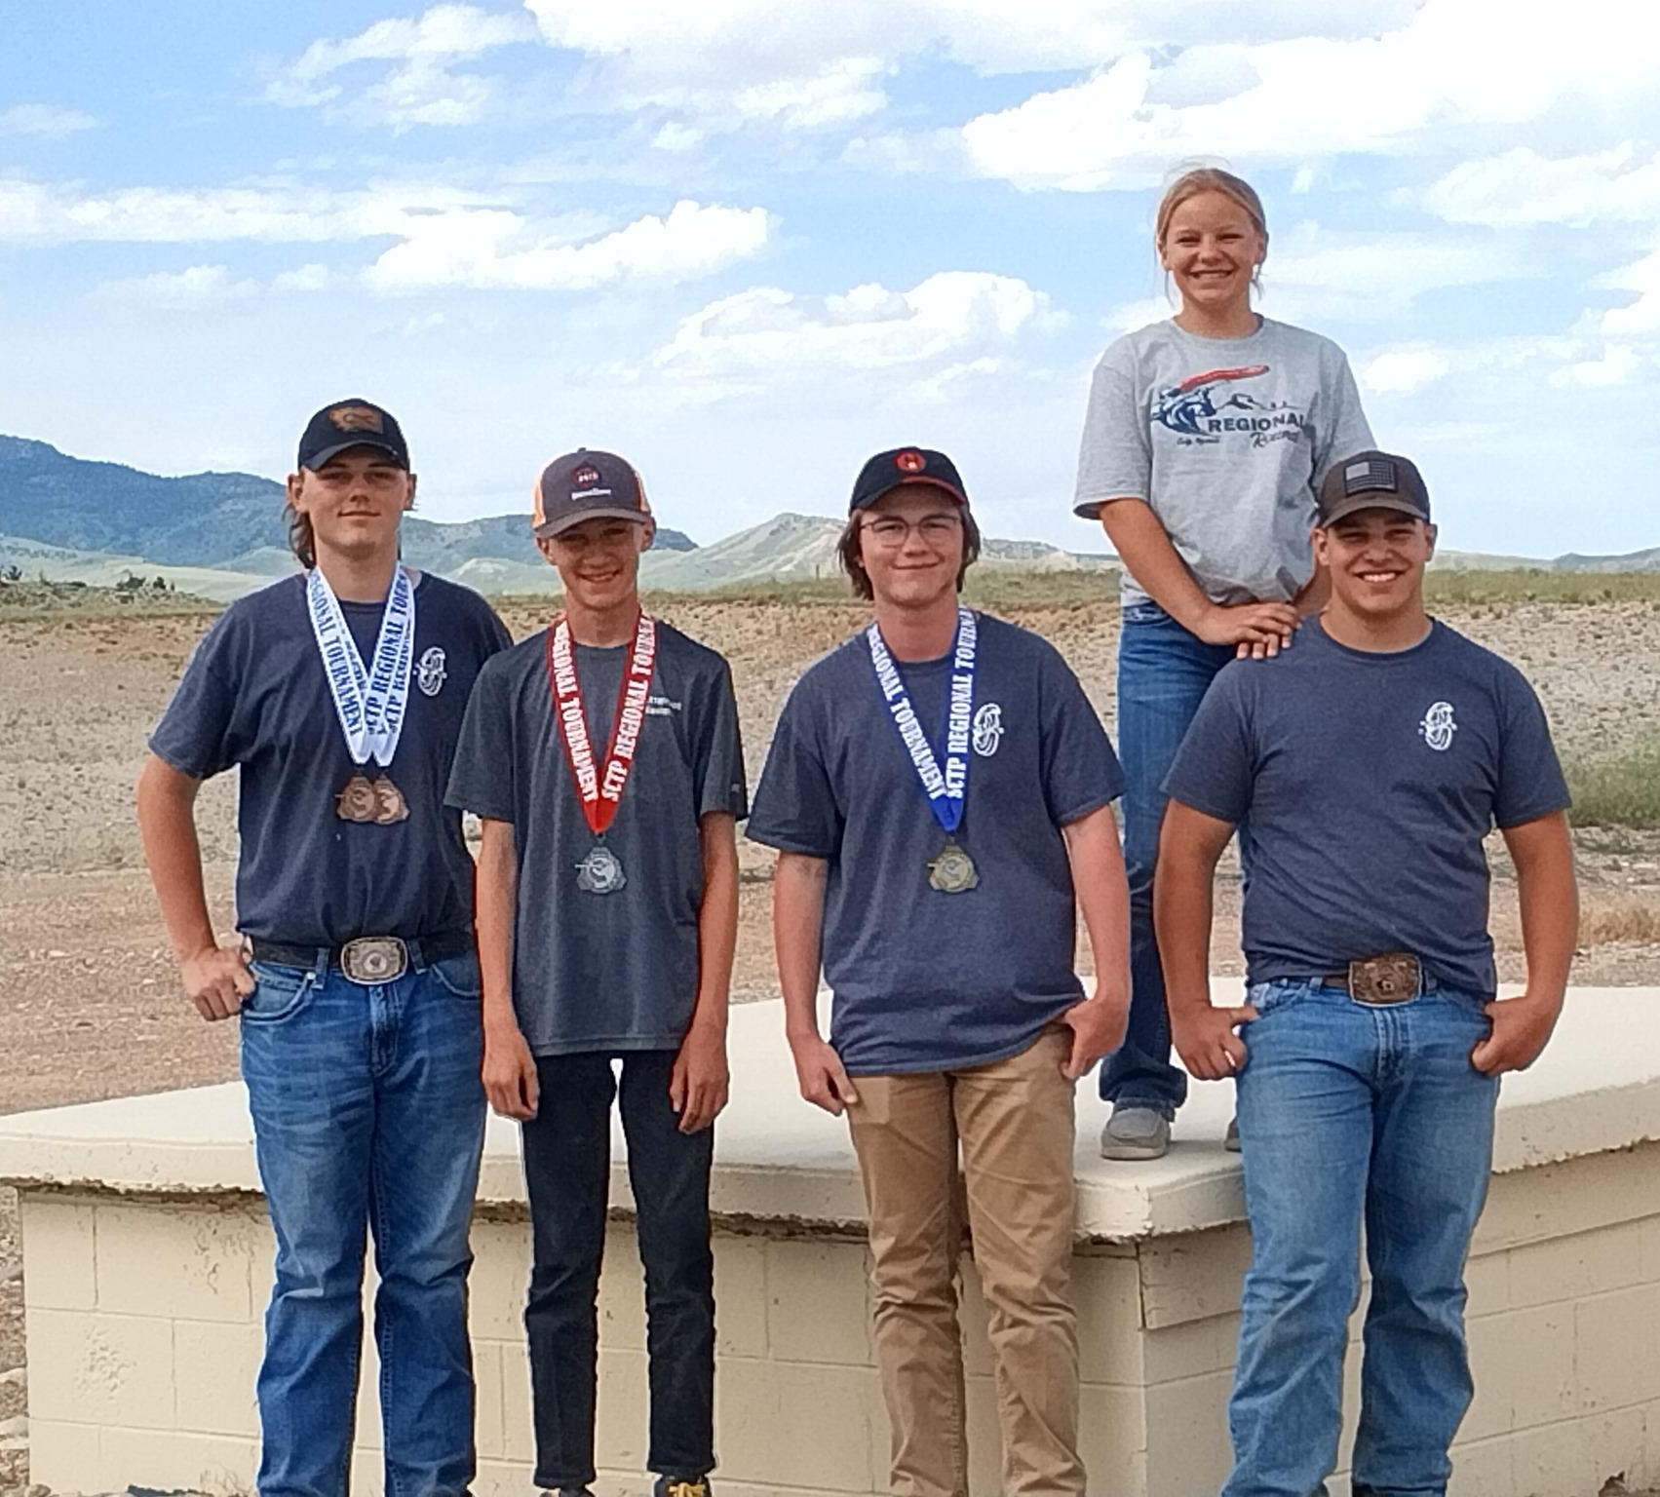
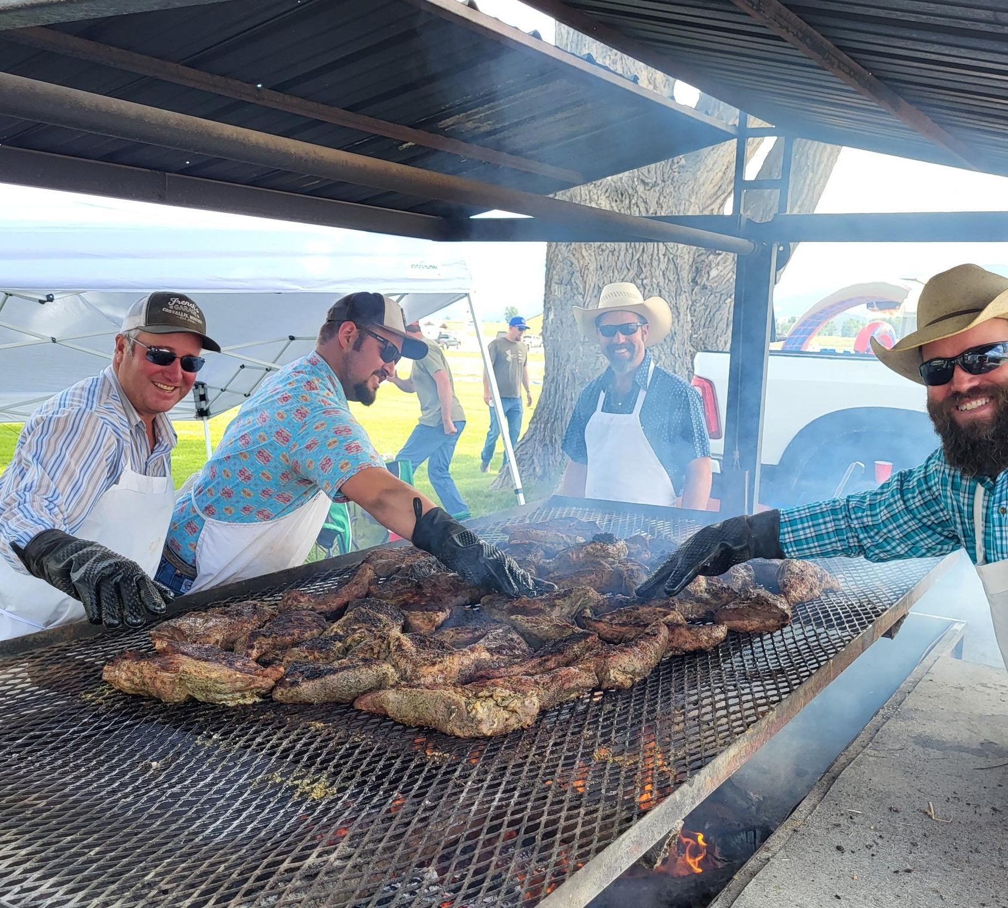
The Future
While our future location is uncertain, we are hoping to find a new home where we can continue the good work currently being done by BSC. We are grateful to those who are willing to assist in any way possible while we navigate these new challenges.

Slide 17
Our Board of Directors For more information or to have your questions answered, please reach out to our Board of Directors. Our Board can provide the most up-to-date and correct information on the changes developing for BSC while we navigate through our property search. Please be wary of information not provided directly by the Board to avoid misinformation.
Bitterroot Sporting Club
P.O. Box 672
Hamilton, MT 59840
Ph: (406) 363-2656 Email: gchamilton304@yahoo.com
President: Larry Ward
(406) 381-9373
Vice President: Jay Grover
(307) 350-7759
Treasurer: Cheryl Wallis
(406) 546-3856
Secretary: Kellie Allsop
(406)696-4024

